Slide 1
Balanced Staff Routing for Maintenance
Đinh Nguyễn Công Quý - 20214927
Vũ Tuấn Minh - 20210597
Hoàng Tú Quyên - 20214929
Lê Tuấn Anh - 20214874

Slide 2
Table of contents
PROBLEM DISCRIPTION
MODELLING
PROPOSED ALGORITHMS
01
02
03
EXPERIMENTAL RESULT
04
Give details about idea of the problem
Give using variables, constraints and objective function
Offer some algorithms to solve the problem
CONCLUSION
05
Show experimental result and analysis
Final conclusion for the problem

Slide 3
01
PROBLEM DISCRIPTION
Details about idea of the problem

Slide 4
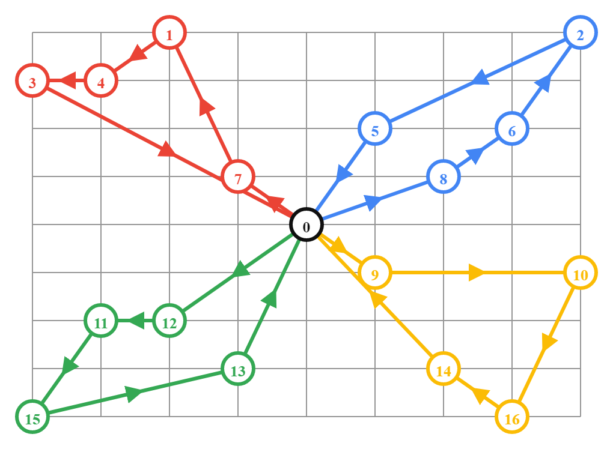
PROBLEM DISCRIPTION
*N customers at N distinct locations (L(i))
*K employees at base (L(0))
+Start from base to customers then come back to base
+Each customer serves by only one employee
+Working time of an employee is sum of travelling time (t) and maintenance time (d)
*Goal : Minimize the longest working time of an employee

Slide 5
02
MODELLING
Variables, Constraints and Objective function.

Slide 6
MODELLING
*Variables
x[i,k] = 1, if customer i is in maintenance schedule of employee k; X[i,k] = 0, if not (với 1 <= i <= N; 1 <= k <= K)
y[i,j,k] = 1, if travelling from i to j is in maintenance schedule of employee k ; Y[i,j,k] = 0, if not(với 0 <= i,j <= N ; 1 <= k <= K)
c[k]: Working time of employee k (với 1 <= k <= K)

Slide 7




MODELLING
*Constraints
Constraint of x,y,c:
K employees start from base:
K employees go back to base:
Only 1 edge to node i and 1 edge from node i in a schedule:
Each customer serves by only one employee:
Subtour elimination constraint:

Slide 8
MODELLING
*Objective function :
max{c[k]} min (1<=k<=K)

Slide 9
03
PROPOSED ALGORITHMS
Offer some algorithms to solve the problem

Slide 10
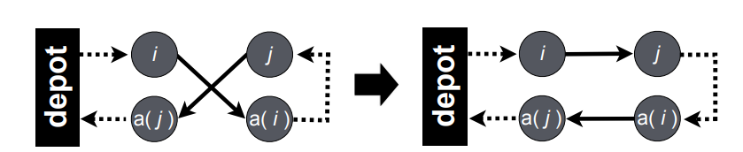
PROPOSED ALGORITHMS
*Greedy algorithm
Construct k tour from k initial points
If a point not in a tour:
Insert point in best fit tour
Optimize the tour using 2-opt algorithm
Stop when there is no unrouted point left
*2-opt algorithm
The main idea behind it is to take a route that crosses over itself and reorder it so that it does not

Slide 11
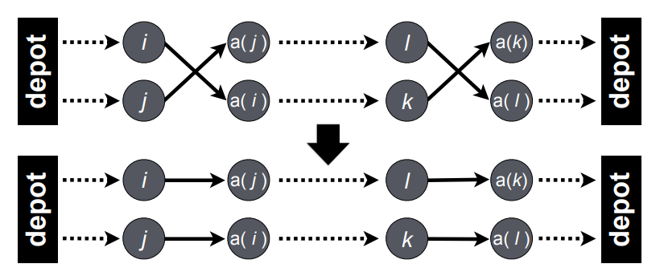
PROPOSED ALGORITHMS
*Local search algorithm
Initialize the initial solution
Generate neighbor by 2 operators:
Move (Move a city from worst tour to best tour)
Exchange (Swap two cities from worst tour to besttour)
If find better solution, replace current solution
Stop when meets stop condition(max iterations number)

Slide 12
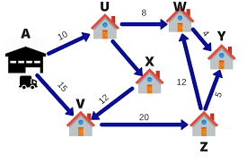
PROPOSED ALGORITHMS
*Integer linear programming algorithm.
Modelling the problem (variables, constraint, objective function)
Using OR-tools library to build solver function
Apply solver to solve the problem

Slide 13
04
EXPERIMENTAL RESULT
Show experimental result and analysis

Slide 14
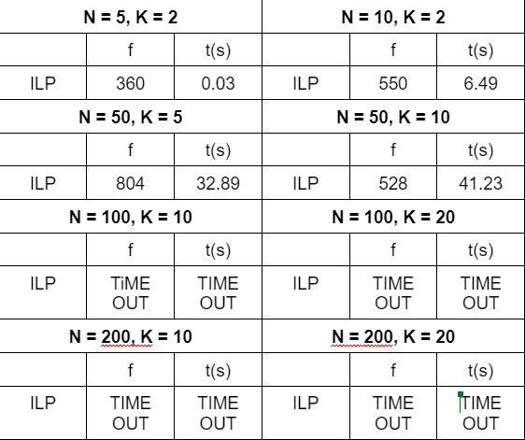
KPI overview

Slide 15
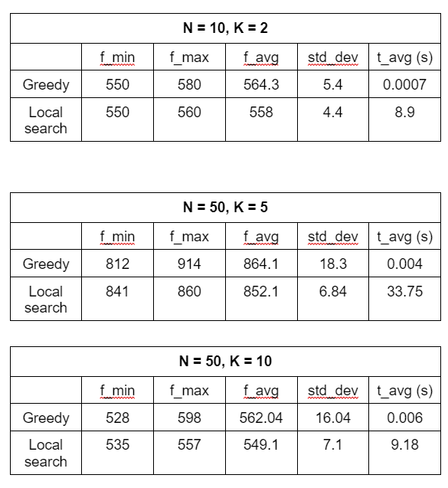
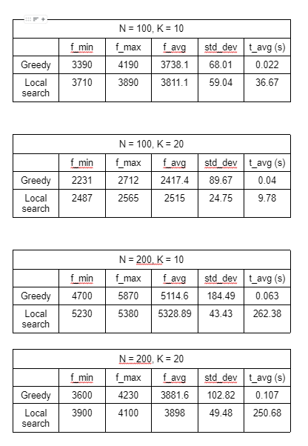
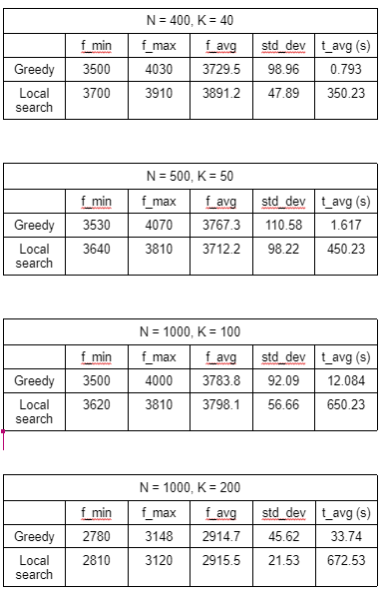
KPI overview

Slide 16
05
CONCLUSION

Slide 17
CONCLUSION
*The problem is challenging since it is NP-hard problem.
*With small data set we should use Integer Linear Programming algorithm for the exact solution.
*With big data set we should use Greedy algorithm for fast performance or Local search algorithm for better feasible solution
*There still have a lot of algorithm that can use to solve the problem and our offer algorithm still need some upgrade for better performance and better feasible solution

Slide 18


